Slide 1
9th Grade Honors English Summer Reading
Mr. Dominick Mayo
Mrs. Christine Zandstra
"You know you’ve read a good book when you turn the last page and feel a little as if you have lost a friend."
— Paul Sweeney
Notes:
Hi - Introductions

Slide 2
Overview of Summer Reading Program
This summer, you will be responsible for reading two (2) books in preparation for English 9 Honors in the fall. The books will be chosen as a 2-book set that have a common topic, author or genre.
You may not choose one book from one set and another book from another set, although we encourage you to read any books of your choosing in addition to the two (2) book requirement.
There will be no written assignment associated with the summer reading assignment; however, we highly encourage you to take notes about your books as you read so that you are prepared to discuss your book in September. It is hard to remember what you were thinking as you were reading weeks or months after you finished the book.
Notes:
Explain two books

Slide 3
Book Resources
To register for a library card, visit Grinnell Library for free e-book loans or curbside pick-up.
Once you get your library card number, you can link it to Overdrive or Hoopla to check out e-books, audiobooks and movies.
You can also buy discount e-books from Bookbub or download audiobooks from Audible
Notes:
Explain two books

Slide 4



Addiction - Choose two (2)

Slide 5
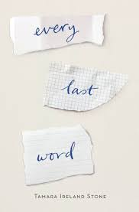


Mental Illness - Choose two (2)

Slide 6



Injustice - Choose two (2)

Slide 7



Body Image - Choose two (2)

Slide 8



Immigration - Choose two (2)

Slide 9



LBGTQ+ - Choose two (2)

Slide 10



Racism - Choose two (2)

Slide 11



Girl Power - Choose two (2)

Slide 12



Science Fiction - Choose two (2)

Slide 13

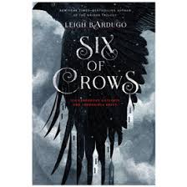

Fantasy - Choose two (2)

Slide 14


Nonfiction - Choose two (2)

Slide 15
Authors - Choose any two (2) from any one author
Laurie Halse Anderson
Jason Reynolds
John Green
Sarah Dessen
Tiffany D. Jackson
Ellen Hopkins
Carl Deuker
David Levithan
Matt de la Pena (age appropriate - no picture books)
Jacqueline Woodson (age appropriate - no picture books)

Slide 16
Getting Started
Decide which text set you would like to explore.
Do some research - go online to find out what the book is about, visit Goodreads or Amazon to read reviews of the books, visit the library or bookstore to see inside (type face, spacing, length, etc.).
Begin reading! Taking notes is highly recommended.

Slide 17
Questions
What if I don’t like my initial book choice?
  You can select any text set on our list. However, your initial choice may not be the best fit for you for a number of reasons. You can change your mind as often as you like between now and September, as long as one text set is completed by the first week of school.
How will I be assessed?
  You will be assessed in September using various measures, including, but not limited to, small and large group discussions, paired and individual writing assignments, and teacher conferences.

Slide 18
Contact Information
Dominick Mayo - dominick.mayo@wcsdny.org
Christine Zandstra - christine.zandstra@wcsdny.org

Slide 19
Happy Reading!!!

